Slide 1
Ground rules
Sustainable
Our PPTs default mode is dark. Energy saved in every slide. Navigate through the bright cover slides and use the Knowit-black-background for everything else.
Accessible
Our columns are narrow and line lengths short for an easy, and accessible read
Keep it simple
Highlight only what strengthens your story. Leave everything else behind. And make every illustration count ☺

Slide 2
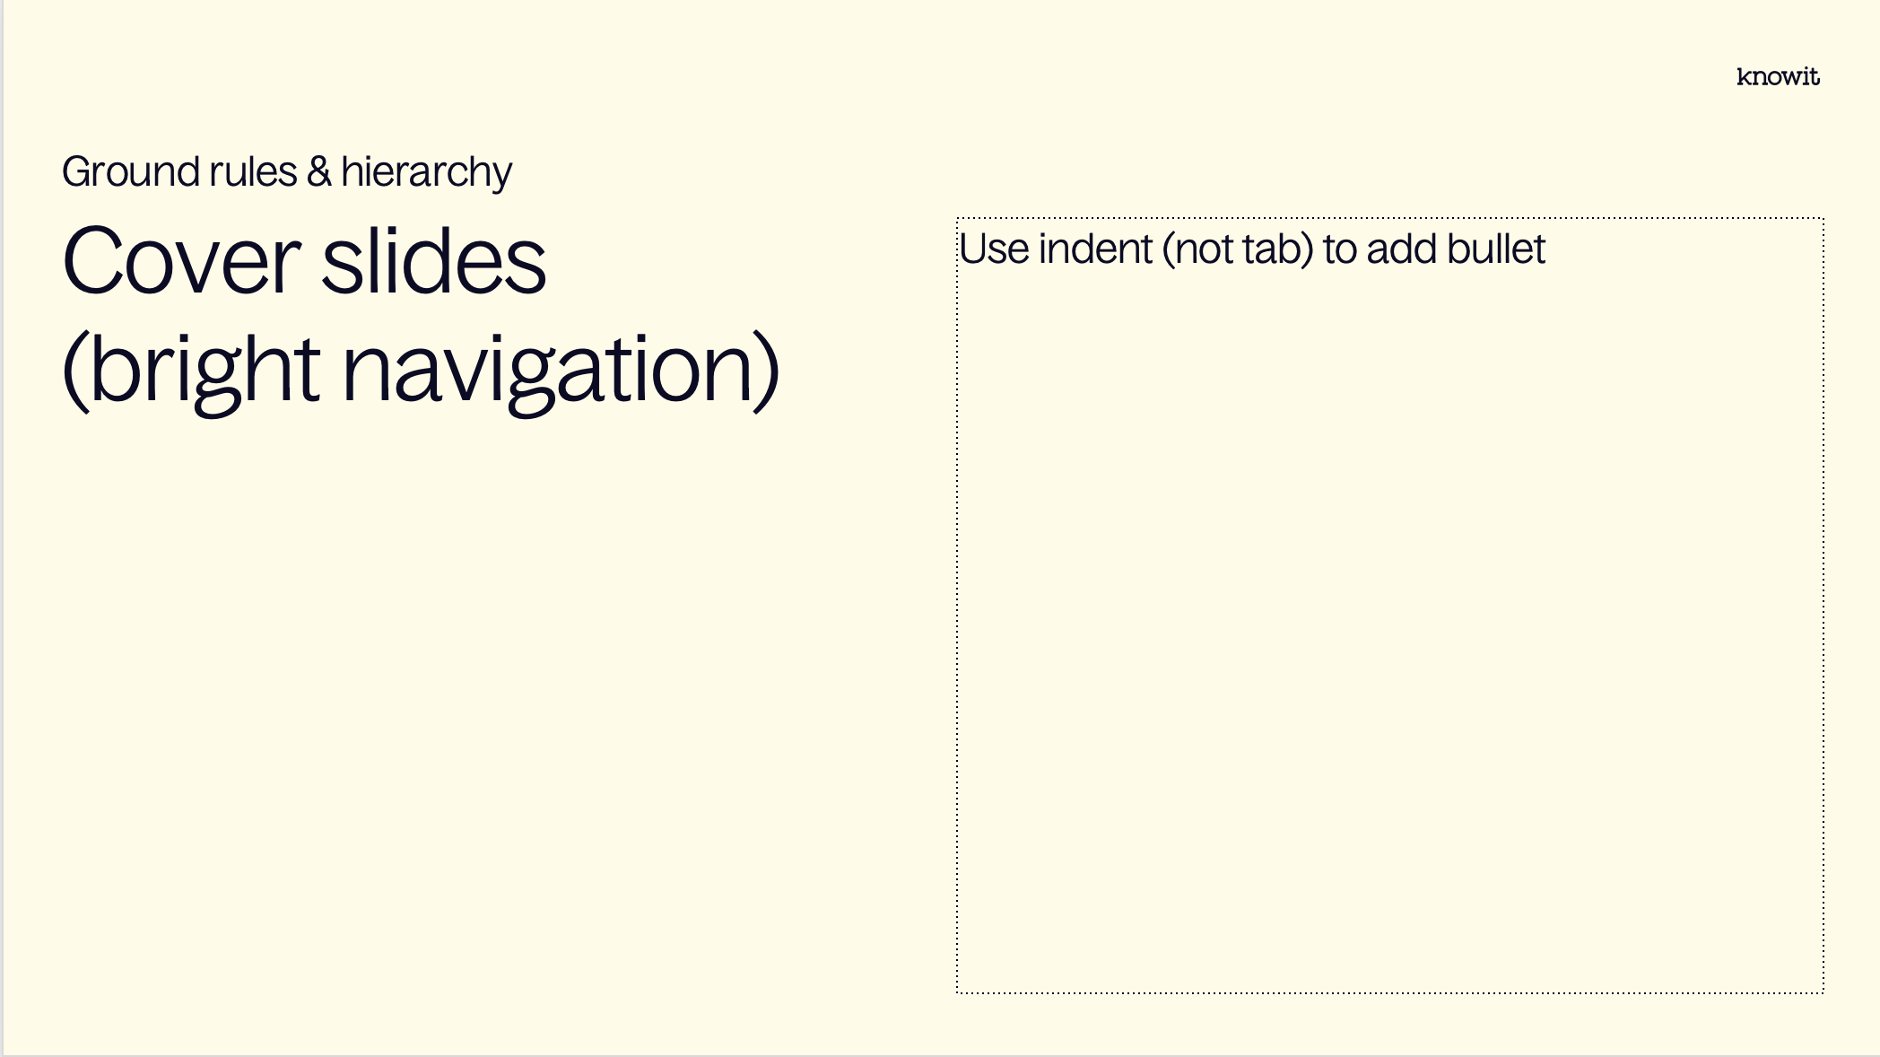
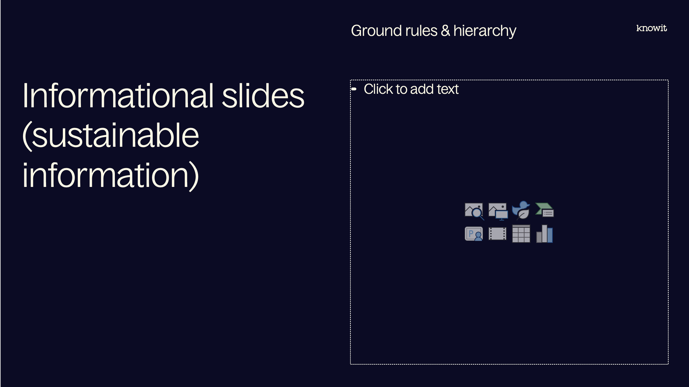
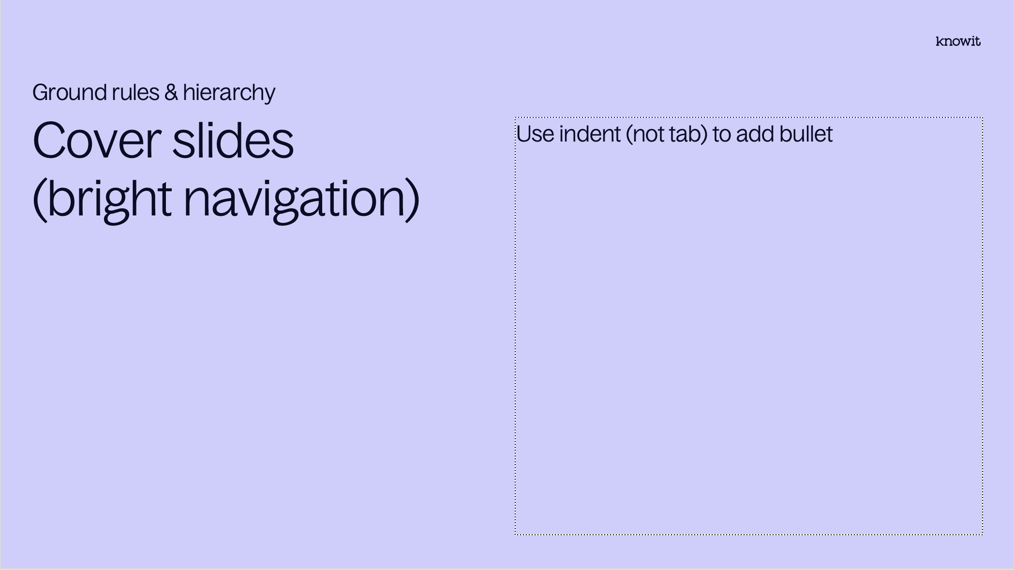
Visual prioritization

Slide 3
PowerPoint skills
Tips
Our template contains 38 different layouts, choose with care (and ask a colleague if you can’t find them)
The layout names might be helpful
Confused about colors or typographic rules? Check out the margins for some guidance
Have fun! (Break some rules if it helps you elevate your kick-ass-content☺)

Slide 5
Embedded academy Assembler and compilers

Slide 6
Content
Introduction
Arm assembler
Compiler flags
Testing assembler code
Debugging
Map and list files

Slide 7
Lab
Introduction
Implement assembler function

Slide 8
Notes from previous session

Slide 9
Reminder for today
Notes from last session
Stack
Flash

Slide 10
Arm assembler

Slide 11
Map and list files

Slide 12
Debugging

Slide 13
Testing assembler code

Slide 14
Compiler flags

Slide 15
Questions?

Slide 16
Lab part

Slide 17












































































Our icons

Slide 18

















UN SDG (PNG)

Slide 19

















UN SDG (SVG)

